Slide 1
Theology & Origins of Creation
Lecture 1

Slide 2
Poll Question
Did God create the universe?
Yes
No
Probably but I’m not sure
There is no way anyone can know for sure.
Notes:
Poll Title: Did God create the universe?
https://www.polleverywhere.com/multiple_choice_polls/FdXGhSq5pPloSaJ?flow=Default&onscreen=persist

Slide 3
Poll Question
How old is the Earth?
3000 - 7000 years old
100,000 years old
1 million years old
10 million years old
1.5 billion years old
4.6 billion years old
100 gazillion million years old give or take an eon.
Notes:
Poll Title: How old is the earth?
https://www.polleverywhere.com/multiple_choice_polls/VuIBG34v5G9namV

Slide 4
Operating assumptions:
Science is a great “way of knowing” and the primary way we learn how the natural world operates. It is what has allowed us to build and design technological tools like computers and cellphones and spacecraft, figure out causes and cures of diseases, and explain how the physical universe operates.
Guide me in your truth and teach me, for you are God my Savior, and my hope is in you all day long. Psalm 25:5 | NIV

Slide 5
But what does that mean???

Slide 6

Let’s Play With Legos
Divide into groups of 2-3.
This activity helps explain the nature of science.
There are specific instructions so make sure you listen carefully

Slide 7

Prep for Next Lecture
Always check Canvas for prep work and complete it
  Next class:
    Word Document “Theology and Origins of Creation” to complete
    Word Document “Genesis Creation Account (NIV version)” to read
    Word Document “Christian Views of Creation” to read

Slide 8
Accountability Quiz
Pull up class Canvas
Quiz is immediately below the assignment & will be under the Quick Links for each week.
Read the instructions
Begin as soon as class starts

Slide 9



Questions?

Slide 10
To state “evolution is taught as theory and not as fact” is not incorrect, but it does perhaps require some clarification.
In science, theories are not just “hunches” or “wild guesses,” they are comprehensive systems of ideas that explain observations and occurrences.
Scientists ask questions and generate predictions called hypotheses.
  Hypotheses can be tested and either verified or falsified using principles of scientific inquiry. Hypotheses which are falsified are either modified and re-tested, or they are thrown out.
  Hypotheses which are verified are accepted and subjected to further testing and, if found to be accurate in a variety of circumstances and conditions, may become parts of a theory.
In science, theories are not facts; theories explain facts and are based on thorough testing and refining.
To say that something is a theory suggests that there is substantial evidence to support it and great explanatory and predictive value found within it.
  In fact, just about everything we study in science is taught as theory (e.g. atomic theory, cell theory, theory of plate tectonics, etc., not just evolution).

Slide 11
Evolution in this course:
Microevolution (change w/in a species) is a given
  Ex: different kinds of dogs from wolf-like ancestor
  Ex: flu virus evolves so different every year
Evolution is a scientifically useful theory
  Need to understand it even if don’t agree with it
Need to respect individuals with different opinions on creation.
Be sensitive to issues of salvation with respect to this issue.

Slide 12
Need to differentiate between the questions
Who?
Who made this happen?
What? What happened?
How?
How did it happen?
Why?
Why did it happen?

Slide 13
Need to differentiate between the questions
Question of philosophy or theology
(Why? Who?)
Evolutionism
(scientism)
(purely naturalistic)
Creationism
(theism)
Question of science
(How?)
Evolution by descent with modification
Instantaneous
origins

Slide 14
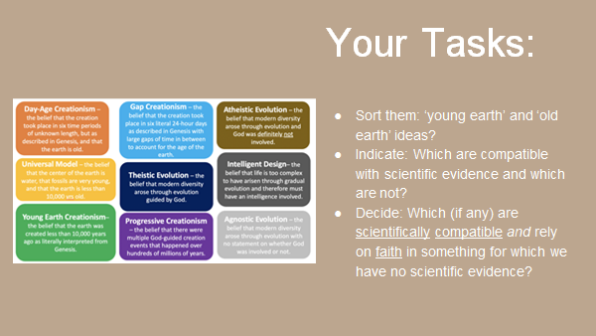

Slide 15
Theological Considerations of the Timing of Creation
Early Christian scholars differed widely in their interpretation of the word used for “day”
  Hebrew for “day” = yom
  Can be translated as a period of daylight, a 24-hour day, or a longer, indefinite period of time
  Genesis 26:8 “When Isaac had been there a long time”
  Genesis 30:14 – refers to wheat harvest time
  Modern equivalent = in my grandfather’s day

Slide 16
The Timing of the Thing
Does the use of ordinal numbers (ie 1st, 2nd etc) change how we interpret yom?
  Some say that with ordinal numbers, yom must be translated as a 24 hour day
  But Hosea 6:2 “After two days he will revive us; on the third day he will restore us, that we may live in his presence”
    Bible commentators note that these “days” refer to a brief time, a year, years, a thousand years, or maybe more.

Slide 17
Biblical Basis for Long Creation Days
Psalm 90:4 For a thousand years in your sight are like a day that has just gone by, or like a watch in the night.
Events of 6th day
  Create land mammals, create Adam, Adam named all animals, none suitable helper so God created Eve
  Lot for one 24 hour day

Slide 18
Theological Basis for long creation days
God is truthful and desires to reveal the truth (he does not trick or deceive)
Bible tells us that creation reveals God’s existence and his power. Seems reasonable to conclude that honest investigation of nature leads to discovery of truths.

Slide 19
Theological Basis for long creation days
Rom 5:12 “Therefore, just as sin entered the world through one man, and death through sin, and in this way death came to all men, because all sinned”
  Some use verse to say no death of any kind before Adam sinned
  “Death through sin” is not equivalent to physical death
  Only humans (with souls) not animals can experience death through sin
  When Adam and Eve ate the fruit in the garden they died – not physically, but spiritually

