Slide 1
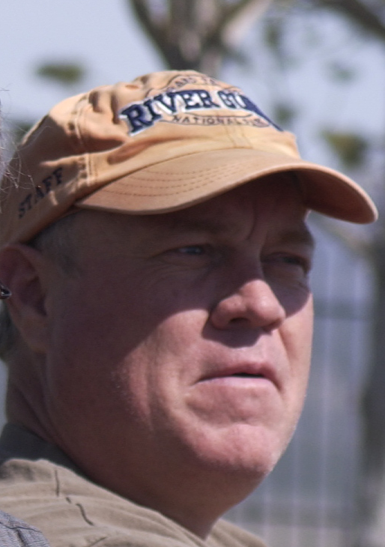
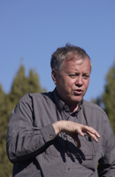

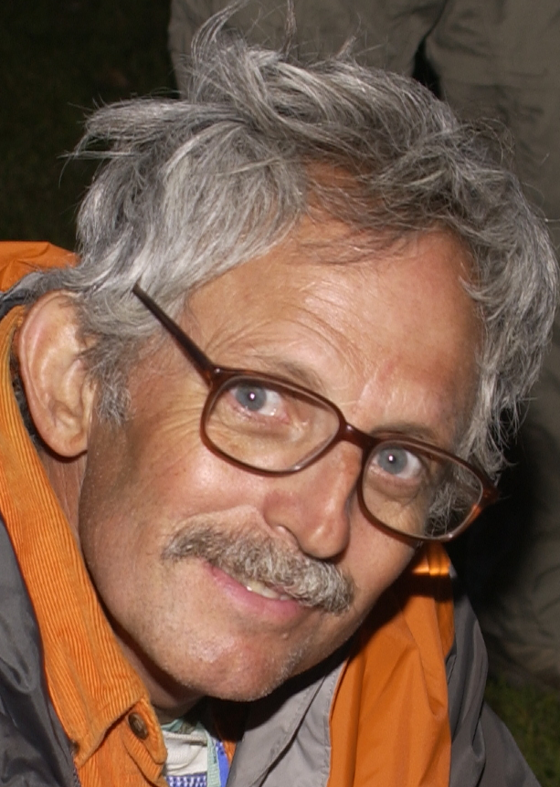
Brian Hill
John Bennion
Brian Cannon
Riley Nelson
Through an innovative program we call Integrated Natural History, students can study biology, recreation management, Utah history, and writing as one subject. During Spring term we will follow four water systems (Vernon Creek, the Provo River, the Bear River, and the Escalante River) from their origins in the mountains to their use in a human community, and to study the relationships between human recreational and economic practice and the plant and animal systems. We will prepare for this expedition Spring 2012 during Winter 2012.
The total program is worth 14 credits, many fulfill General Education and Honors requirements:
Winter: 5 hours of credit •Brian Hill, RMYL: Outdoor Skills Leadership (223R, two hours) •John Bennion, Brian Cannon, and Riley Nelson: Honors Special Topics (Honors 295, 3 credits) Spring: (9 hours of credit) •John Bennion, Writing (Writing 150H or English 218: Introduction to Creative Writing (3 credits). •Brian Cannon, History and Redd Center: Utah History (Honors 232R, 3 credits) •Riley Nelson, Principles of Biology: Honors Biology 100 (3 credits).
For more information contact john_bennion@byu.edu. For additional information visit Dr. Riley Nelson when you happen to see him in the halls or email him at rileynelson@byu.edu. Recycle this poster after 15 June 2012, save the stonefly save the world.
Integrated Natural History of Utah 2012
john_bennion@byu.edu
Integrated Natural History of Utah 2012
john_bennion@byu.edu
Integrated Natural History of Utah 2012
john_bennion@byu.edu
Integrated Natural History of Utah 2012
john_bennion@byu.edu
Integrated Natural History of Utah 2012
john_bennion@byu.edu
Integrated Natural History of Utah 2012
john_bennion@byu.edu
Integrated Natural History of Utah 2012
john_bennion@byu.edu
Integrated Natural History of Utah 2012
john_bennion@byu.edu
Integrated Natural History of Utah 2012
john_bennion@byu.edu
Integrated Natural History of Utah 2012
john_bennion@byu.edu
Integrated Natural History of Utah 2012
john_bennion@byu.edu
Integrated Natural History of Utah 2012
john_bennion@byu.edu
Integrated Natural History of Utah 2012
john_bennion@byu.edu
Integrated Natural History of Utah 2012
john_bennion@byu.edu
Integrated Natural History of Utah 2012
john_bennion@byu.edu

