Slide 1
Evolution and
The Church of Jesus Christ of Latter-day Saints

Slide 2

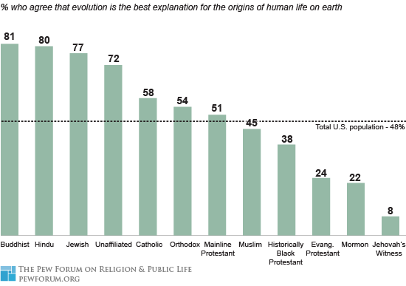
Pewforum.org, 2008
Miller, 2006
Notes:
Why low acceptance of evolution is concerning!
People are unable to fully engage in…
If we look at how the U.S. ranks among evolution acceptance…
39% accept
36% uncertain
…down from 45 and 40.

Slide 3
Current State of Our Nation
“Evolution is the best explanation for life on earth.”
Pew Forum 2008
US Population

Slide 4
Current State of the Youth
Pew Forum 2008
“Evolution is the best explanation for life on earth.”
Agree
Disagree
Mormon
χ²(1) = 10.53, p = .001

Slide 5
Gallup 2014
Which of the following statements comes closest to your views on the origin and development of human beings?
Human beings have developed over millions of years from less advanced forms of life, but God guided this process
Human beings have developed over millions of years from less advanced forms of life, but God had no part in this process
God created human beings pretty much in their present form at one time within the last 10,000 years or so

Slide 6
Theodosius Dobzhansky
“Nothing in biology makes sense except in the light of evolution.”

Slide 7
In what ways is the study of evolution compatible with our theology?
the BIG picture

Slide 8
Science and Religion Answer Different Questions
Science:
How?
When?
Religion:
Who?
Why?
“There is no conflict between science and religion. Conflict only arises from an incomplete knowledge of either science or religion, or both…This university is committed to search for truth, and teach the truth,” said Elder Nelson. “All truth is part of the gospel of Jesus Christ. Whether truth comes from a scientific laboratory or by revelation from the Lord, it is compatible.” Elder Russell M. Nelson of the Quorum of the Twelve Apostles said during the dedication of the new Life Sciences Building at Brigham Young University on April 9, 2015.

Slide 9
Jacob 4:8 – 9
8 Behold, great and marvelous are the ªworks of the Lord. How ^{b}unsearchable are the depths of the ^{c}mysteries of him; and it is impossible that man should find out all his ways. And no man ^{d}knoweth of his ^{e}ways save it be revealed unto him; wherefore, brethren, despise not the ^{f}revelations of God.
9 For behold, by the power of his ªword ^{b}man came upon the face of the earth, which earth was ^{c}created by the power of his word. Wherefore, if God being able to speak and the world was, and to speak and man was created, O then, why not able to command the ^{d}earth, or the workmanship of his hands upon the face of it, according to his will and pleasure?

Slide 10
Are We Creationists?

Slide 11
Genesis 1
20 And God said, Let the waters bring forth abundantly the moving creature that hath life, and fowl that may fly above the earth in the open firmament of heaven.
21 And God created great whales, and every living creature that moveth, which the waters brought forth abundantly, after their kind, and every winged fowl after his kind: and God saw that it was good.

Slide 12
Genesis 1
26 And God said, Let us make man in our image, after our likeness: and let them have dominion over the fish of the sea, and over the fowl of the air, and over the cattle, and over all the earth, and over every creeping thing that creepeth upon the earth.
27 So God created man in his own image, in the image of God created he him; male and female created he them.

Slide 13
Creationist Creed
“Since nothing in the world has been created since the end of the creation period, everything must then have been created by means or processes which are no longer in operation and which we therefore cannot study by any of the means of science. We are limited exclusively to divine revelation as to the date of creation, the duration of creation, the method of creation, and every other question concerning creation.”
Henry Morris (Creation Research Institute)
Notes:
13
Based on the premise that the mechanisms of creation are not open to scientific investigation.
This is a very different view from the LDS packet
“Our religion is not hostile to real science. That which is demonstrated, we accept with joy….”

Slide 14
Creationist History
1910-1915 : A set of Christian tracts emerged in the US which took a literalistic interpretation of Genesis (ex nihilo creation).
1920-1968: Evolution banned from public schools
1963: Creation Research Society, Institute for Creation Research
1975: “Equal Time” (Tennessee)
1981, 1987: “Balanced treatment” (Arkansas, Louisiana)
1995 – 1996: “Evolution as theory” (Tennessee)
2000: “Intelligent Design”
Notes:
14
Creation Research Society, Institute for Creation Research: Societies created in an effort to make creationism more ‘scientific’. However, these efforts served only to try to discredit evolution.
Equal Time (from Wikipedia): Daniel v. Waters, 515 F.2d 485 (6th Cir. 1975)^{[1]} was a 1975 legal case in which the United States Court of Appeals for the Sixth Circuit struck down Tennessee's law regarding the teaching of "equal time" of evolution and creationism in public school science classes because it violated the Establishment clause of the US Constitution.
The plaintiffs were school teachers supported by the National Association of Biology Teachers.
Balanced Treatment (from Wikipedia): McLean v. Arkansas Board of Education, 529 F. Supp. 1255, 1258-1264 (ED Ark. 1982), was a 1981 legal case in Arkansas.
A lawsuit was filed in the United States District Court for the Eastern District of Arkansas by various parents, religious groups and organizations, biologists, and others who argued that the Arkansas state law known as the Balanced Treatment for Creation-Science and Evolution-Science Act(Act 590), which mandated the teaching of "creation science" in Arkansas public schools, was unconstitutional because it violated the Establishment Clause of the First Amendment to the United States Constitution.
Judge William Overton handed down a decision on January 5, 1982, giving a clear, specific definition of science as a basis for ruling that creation science is religion and is simply not science. The ruling was not binding on schools outside the Eastern District of Arkansas but had considerable influence on subsequent rulings on the teaching of creationism.^{[1][2]}
Arkansas did not appeal the decision and it was not until the 1987 case of Edwards v. Aguillard, which dealt with a similar law passed by the State of Louisiana, that teaching "creation science" was ruled unconstitutional by the Supreme Court, making that determination applicable nationwide.^{[3]}
Evolution as a theory: In 1996, the State of Tennessee debated and narrowly defeated a bill that would have made teachers who taught evolution as a fact - rather than as a theory - subject to dismissal for insubordination (Matsumura 1995b). In late 1995, Alabama passed a state science curriculum that required that evolution be taught "as theory rather than fact" (Scott 1995). These are not the first such cases; NCSE has records of school-board controversies or individual teachers' complaints concerning pressure to teach evolution as a theory and not fact from Alabama, Arkansas, California, Florida, Georgia, Louisiana, Pennsylvania, Texas, and Wisconsin, among other places.
Intelligent Design (from IntelligentDesign.org) What is intelligent design?
Intelligent design refers to a scientific research program as well as a community of scientists, philosophers and other scholars who seek evidence of design in nature. The theory of intelligent design holds that certain features of the universe and of living things are best explained by an intelligent cause, not an undirected process such as natural selection. Through the study and analysis of a system's components, a design theorist is able to determine whether various natural structures are the product of chance, natural law, intelligent design, or some combination thereof. Such research is conducted by observing the types of information produced when intelligent agents act. Scientists then seek to find objects which have those same types of informational properties which we commonly know come from intelligence. Intelligent design has applied these scientific methods to detect design in irreducibly complex biological structures, the complex and specified information content in DNA, the life-sustaining physical architecture of the universe, and the geologically rapid origin of biological diversity in the fossil record during the Cambrian explosion approximately 530 million years ago.

Slide 15
Creationist History
1910-1915 : A set of Christian tracts emerged in the US which took a literalistic interpretation of Genesis (ex nihilo creation).
1920-1968: Evolution banned from public schools
1963: Creation Research Society, Institute for Creation Research
1975: “Equal Time” (Tennessee)
1981, 1987: “Balanced treatment” (Arkansas, Louisiana)
1995 – 1996: “Evolution as theory” (Tennessee)
2000: “Intelligent Design”
Intelligent design refers to a scientific research program as well as a community of scientists, philosophers and other scholars who seek evidence of design in nature. The theory of intelligent design holds that certain features of the universe and of living things are best explained by an intelligent cause, not an undirected process such as natural selection. Through the study and analysis of a system's components, a design theorist is able to determine whether various natural structures are the product of chance, natural law, intelligent design, or some combination thereof. Such research is conducted by observing the types of information produced when intelligent agents act. Scientists then seek to find objects which have those same types of informational properties which we commonly know come from intelligence. Intelligent design has applied these scientific methods to detect design in irreducibly complex biological structures, the complex and specified information content in DNA, the life-sustaining physical architecture of the universe, and the geologically rapid origin of biological diversity in the fossil record during the Cambrian explosion approximately 530 million years ago.
Notes:
15
In particular they argued for ex nihilo creation, Sovereign God, Literal interpretation of time periods, God spoke everything into existence (time, space, matter)
Based on the premise that evolution is simply wrong and that they are going to prove it. Their modus operandi is to strongly argue that any evidence which can be used to punch holes in evolution in turn bolsters their theory. Thus they are not required to produce evidence that their ideas are correct, only that evolution is incorrect.
Similar style as anti-Mormon literature: ad hominim attacks, selective referencing, distortion of data, misrepresentation of results.
Equal time – “Teach the Controversy”
Balanced Treatment (from Wikipedia): McLean v. Arkansas Board of Education, 529 F. Supp. 1255, 1258-1264 (ED Ark. 1982), was a 1981 legal case in Arkansas.
A lawsuit was filed in the United States District Court for the Eastern District of Arkansas by various parents, religious groups and organizations, biologists, and others who argued that the Arkansas state law known as the Balanced Treatment for Creation-Science and Evolution-Science Act(Act 590), which mandated the teaching of "creation science" in Arkansas public schools, was unconstitutional because it violated the Establishment Clause of the First Amendment to the United States Constitution.
Judge William Overton handed down a decision on January 5, 1982, giving a clear, specific definition of science as a basis for ruling that creation science is religion and is simply not science. The ruling was not binding on schools outside the Eastern District of Arkansas but had considerable influence on subsequent rulings on the teaching of creationism.^{[1][2]}
Arkansas did not appeal the decision and it was not until the 1987 case of Edwards v. Aguillard, which dealt with a similar law passed by the State of Louisiana, that teaching "creation science" was ruled unconstitutional by the Supreme Court, making that determination applicable nationwide.^{[3]}
Evolution as a theory: In 1996, the State of Tennessee debated and narrowly defeated a bill that would have made teachers who taught evolution as a fact - rather than as a theory - subject to dismissal for insubordination (Matsumura 1995b). In late 1995, Alabama passed a state science curriculum that required that evolution be taught "as theory rather than fact" (Scott 1995). These are not the first such cases; NCSE has records of school-board controversies or individual teachers' complaints concerning pressure to teach evolution as a theory and not fact from Alabama, Arkansas, California, Florida, Georgia, Louisiana, Pennsylvania, Texas, and Wisconsin, among other places.
Intelligent Design (from IntelligentDesign.org) What is intelligent design?
Intelligent design refers to a scientific research program as well as a community of scientists, philosophers and other scholars who seek evidence of design in nature. The theory of intelligent design holds that certain features of the universe and of living things are best explained by an intelligent cause, not an undirected process such as natural selection. Through the study and analysis of a system's components, a design theorist is able to determine whether various natural structures are the product of chance, natural law, intelligent design, or some combination thereof. Such research is conducted by observing the types of information produced when intelligent agents act. Scientists then seek to find objects which have those same types of informational properties which we commonly know come from intelligence. Intelligent design has applied these scientific methods to detect design in irreducibly complex biological structures, the complex and specified information content in DNA, the life-sustaining physical architecture of the universe, and the geologically rapid origin of biological diversity in the fossil record during the Cambrian explosion approximately 530 million years ago.

Slide 16
What is the Church’s stance on evolution? Are we ‘creationists’?
Notes:
16
We are lucky in being LDS, in that we have a greater knowledge of the creation and the fall than any other religion. The Books of Moses and Abraham both specifically deal with creation, as well as the Temple. The Book of Mormon also provides marvelous insights into the why’s of creation.

Slide 17

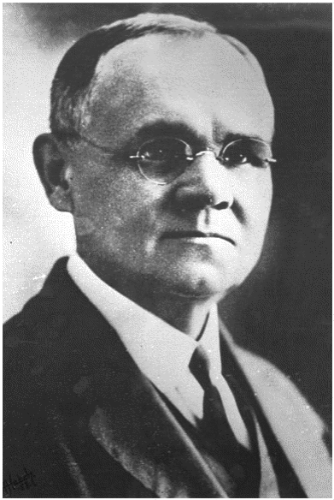
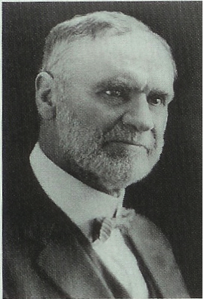
Official statements of the Church on evolution
08 – First Presidency (Joseph F. Smith, President) appoints a committee to prepare a statement on the Origin of Man
Why ?
Orson Whitney
James Talmage
1900
1925
1950
1975
2000

Slide 18
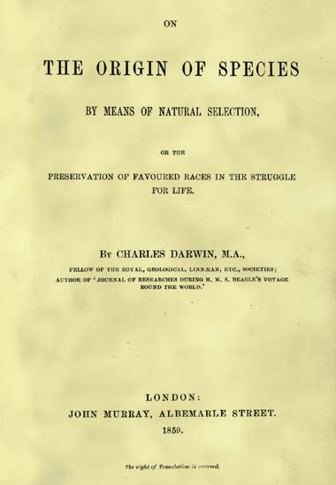
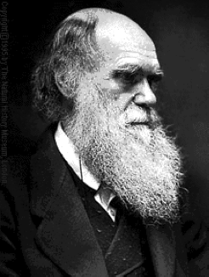
Born 1809
Published 1859

Slide 19
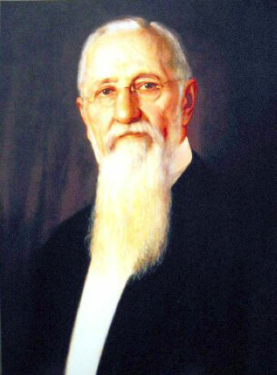
Official statements of the Church on evolution
09 – The Statement is Published in the Improvement Era
over the signature of the First Presidency
President
Joseph F. Smith
1. Adam took upon himself
“an appropriate body”
2. Anti-evolution tone is clear,
but no explicit rejection of
evolution
1900
1925
1950
1975
2000

Slide 20
Official statements of the Church on evolution
10 – First Presidency Christmas Message – “Our religion is not hostile to real science. That which is demonstrated we accept with joy.”
President
Joseph F. Smith
Image: LDS church
1900
1925
1950
1975
2000

Slide 21
Our Church embraces science, and always has:
Joseph Smith, 1843: “One of the grand fundamental principles of ‘Mormonism’ is to receive truth, let it come from which it may.”
“[The twentieth century] has been the best of all centuries. … The life expectancy of man has been extended by more than twenty-five years… The fruits of science have been manifest everywhere… This has been an age of enlightenment.” - President Gordon B. Hinckley, April 1999
Notes:
In dealing with this hypothesis, I want to point out a couple of things.
First, I want to emphasize that the Official position of the Church toward science has not changed since its inception back in the 1800’s. Joseph Smith, the founding prophet of our Church said…
The First Presidency of the Church, which includes the current Prophet and his two counselors said, in 1910…
And a recent Prophet of the Church said in 1999…

Slide 22
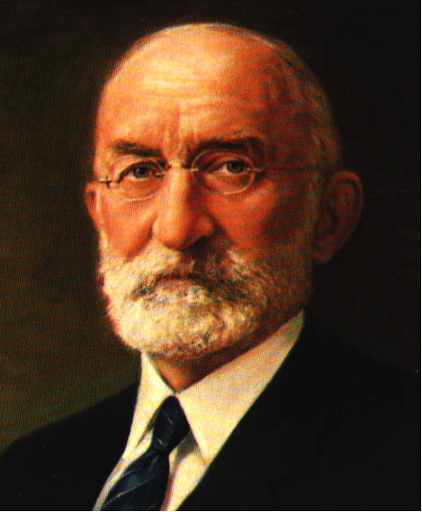
Official statements of the Church on evolution
25 – The Mormon View of Evolution
President
Heber J. Grant
(1918-1945)
Why?
This is a shortened version of
The 1909 statement, but with the
anti-evolution sentiments removed.
1900
1925
1950
1975
2000

Slide 23

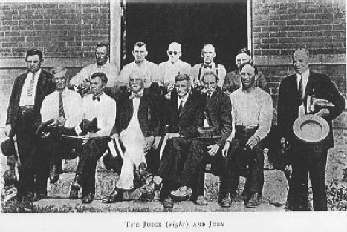
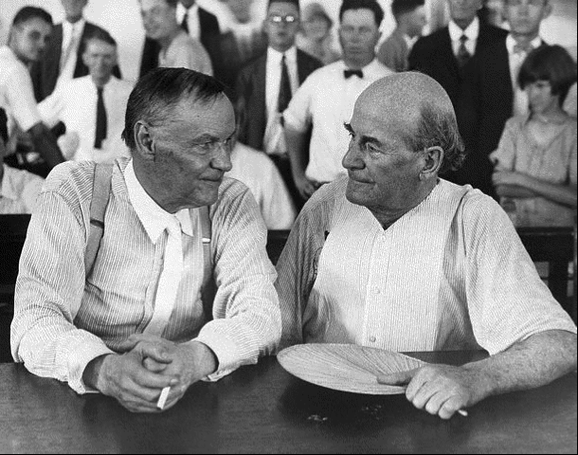
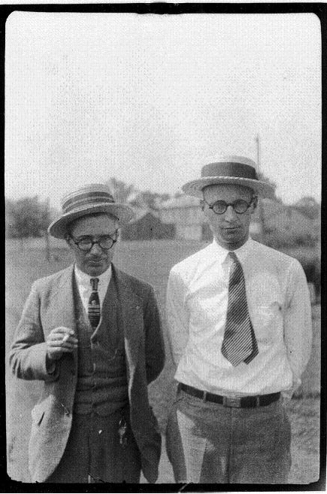
Scopes “Monkey Trial” (10-25 July 1925)
William Jennings Bryan
Clarence Darrow
John Thomas Scopes

Slide 24
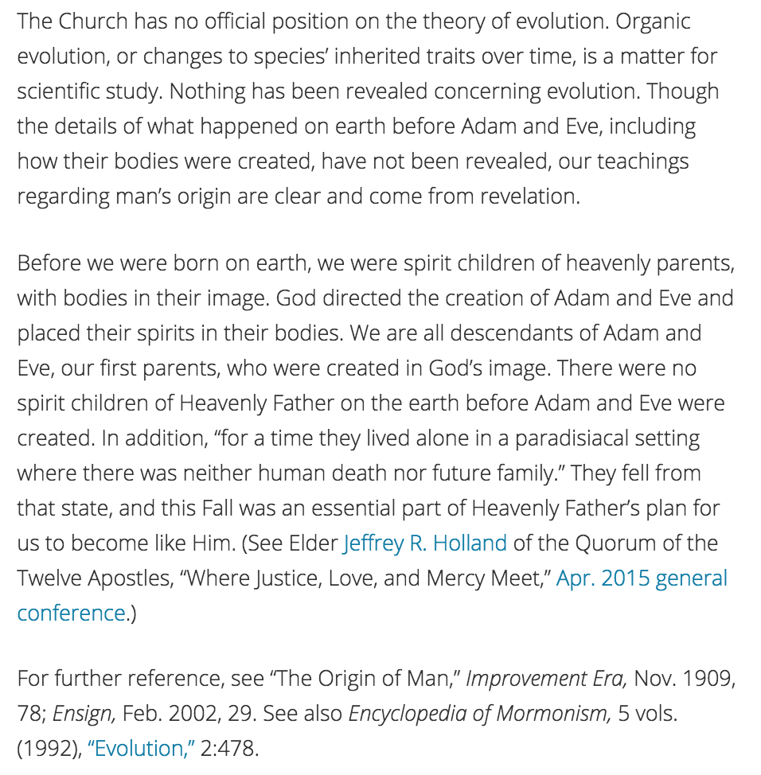
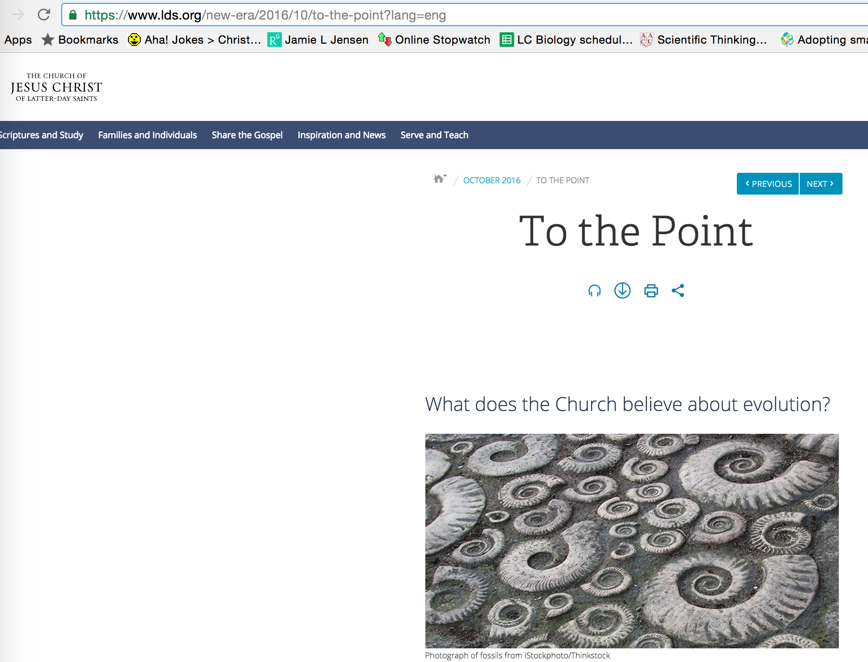
History of the Church and Evolution
2016 – New Era
1900
1925
1950
1975
2000

Slide 25
Why is there so much perceived controversy in our culture?

Slide 26
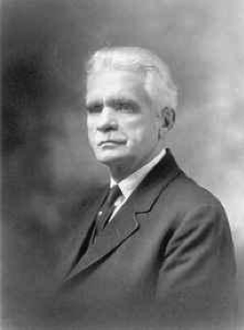

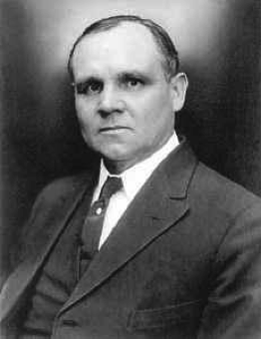
History of the Church and Evolution
(28 – 31) – Dispute between B.H. Roberts and Joseph Fielding Smith. First Presidency sanctioned a response by James Talmage.
University of Utah collections
University of Utah collections
B.H.Roberts
Joseph Fielding Smith
The Truth, The Way, The Life
1900
1925
1950
1975
2000
University of Utah collections
James Talmage
The Earth and Man

Slide 27
The Talmage speech was given in the Tabernacle in August 1931, and, after some resistance from Elder Smith but with the blessing of the First Presidency, it was published first in the Church News and then by the church as a pamphlet. In the speech, Elder Talmage (a geologist by training) strongly emphasized that countless organisms had lived and died for millions of years before the fall of Adam, some small portion of them becoming fossils. He also quoted scripture and expressed his conviction that Adam was indeed the first member of the human race, that we existed previously in heaven, and that we were created in the image of God (pp. 68—70).

Slide 28
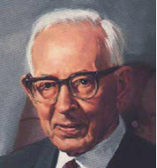
History of the Church and Evolution
54 – Joseph Fielding Smith publishes his anti-evolutionary book Man His Origin and Destiny
David O. McKay
prophet at the time
President J. Rueben Clark gives
his famous talk “When are church
leaders’ words (considered)
scripture”
Joseph Fielding Smith
1900
1925
1950
1975
2000

Slide 29

Q. Who provides official church doctrine?
A. Prophet (First Presidency)
President Clark stated, "When any man, except
the president of the church, undertakes to proclaim
one unsettled doctrine, as among two or more
doctrines, in dispute, as the settled doctrine of
the church, we may know that he is not 'moved upon
by the Holy Ghost,' unless he is acting under the
direction and by authority of the president."
Also see http://www.mormonnewsroom.org/article/approaching-mormon-doctrine

Slide 30
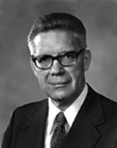
History of the Church and Evolution
58 – Bruce R. McConkie publishes Mormon Doctrine
David O. McKay
prophet at the time
Bruce R. McConkie
1900
1925
1950
1975
2000

Slide 31
Predictably, the publication of Mormon Doctrine reignited the debate surrounding the church's position on evolutionary theory. The "number of inquiries we receive concerning our attitudes on the teaching . . . that death came into the world with the fall of Adam . . . has intensified," wrote Armin J. Hill, dean of BYU's College of Physical and Engineering Sciences, to President McKay in early 1959. While "we accept the Fall as initiating physical death among human beings," Hill explained, McConkie's assertion that there was no death for "all living things" prior to the Fall "cannot be referring to the world we now live in because there is altogether too much evidence that plants and animals lived and died prior to the time we usually ascribe to Adam's mortal life."
Nearly two months later, the First Presidency directed secretary Joseph Anderson to answer, "Until either the Lord speaks directly upon the matter, or until the scientists are able to say that they have the ultimate truth concerning these matters, it would only be confusing for the First Presidency to make any statement regarding such things." Two weeks after receiving Hill's letter, President McKay was asked specifically if Mormon Doctrine represented the church's position on evolution and responded that, like Man: His Origin and Destiny, Mormon Doctrine was not an "official publication of the church," adding, "The church has issued no official statement on the subject of the theory of evolution" (McKay to Christensen).⁵⁶

Slide 32
Twenty years after B. H. Roberts, Widtsoe acknowledged the existence of "human-like [p. 152] beings before the coming of Adam," adding, "The mystery of the creation of Adam has not yet been revealed." To one reader, Widtsoe privately explained in 1948, "If [the Lord] chose to place man-like beings upon the earth before the days of Adam, I really have no right to find fault with that. . . . There is so much connected with these matters that we do not understand that I am willing to take what little we know of a factual nature without offering any interpretations that may mislead others."⁴³

Slide 33
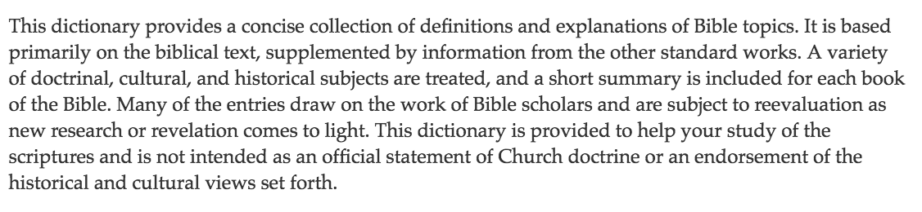
History of the Church and Evolution
70’s – Bible Dictionary
https://www.lds.org/scriptures/bd?lang=eng
“Since 1979, [the] Bible Dictionary has been published as an appendix to most copies of the King James Version (KJV) of the Bible printed by the LDS Church…[It] was created in the 1970s by the Scriptures Publications Committee of the LDS Church. This committee was chaired by Thomas S. Monson, then a member of the Quorum of the Twelve Apostles. The committee delegated the responsibility of creating an LDS bible dictionary to Robert J. Matthews, a Brigham Young University Professor of Ancient Scripture. Matthews gained permission from Cambridge University Press to use their bible dictionary as the template for the LDS version…the majority of the content of the Bible Dictionary is identical to the Cambridge publication.
1900
1925
1950
1975
2000
Notes:
No death before the fall was said by McConkie in his book. It is also in the Bible Dictionary. The Bible Dictionary was written by Robert J. Matthews. So, McConkie got that verbiage from Matthews.

Slide 34
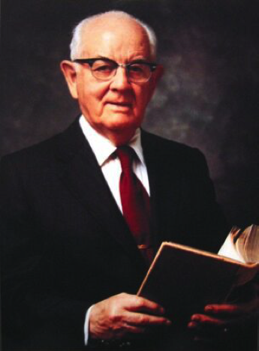
History of the Church and Evolution
75 – President Kimball addresses the General Women’s Conference
“We don’t know” how Adam and Eve got their bodies, but “the story of the rib, of course, is figurative.”
Ensign 3.1976:70-72
President
Spencer W. Kimball
1900
1925
1950
1975
2000

Slide 35

History of the Church and Evolution
92 – Encylopedia of Mormonism & “BYU Evolution Packet”
Encyclopedia entry on ‘evolution’ written over Evenson’s signature but with significant input from the First Presidency (note access to First Presidency Minutes).
BYU Dean
Bill Evenson
1900
1925
1950
1975
2000

Slide 36
What does this mean for you?
"Religion without science is blind," Albert Einstein once observed, and "science without religion is lame."
Veteran BYU geologist George Hansen has echoed: "Science and religion have to go hand in hand--that's part of the greatness of BYU. . . . Kids who come through [the university] are endowed with a feeling of uniformity of [truth], . . . but you can't memorize one passage of scripture and know all the answers to all the problems of the universe."80

Slide 37
What does this mean for you?
Flat Earth
Young Earth
Special Creation
Geocentrism
Universal Model
Young Earth Creationism
Intelligent Design
Old Earth
Gap Creationism
Day-Age Creationism
Progressive Creationism
Theistic Evolution
Potentially Scientifically Compatible
Agnostic Evolution
Atheistic Evolution

Slide 38
And behold, all things have their likeness, and all things are created and made to bear record of me; both things which are temporal, and things which are spiritual; things which are in the heavens above, and things which are on the earth, and things which are in the earth, and things which are under the earth, both above and beneath: all things bear record of me.
-Moses 6:63

Slide 39
It’s magic!
Smoothini the Ghetto Houdini: https://www.youtube.com/watch?v=ZTy3qG_qInU&vl=en

