Slide 1
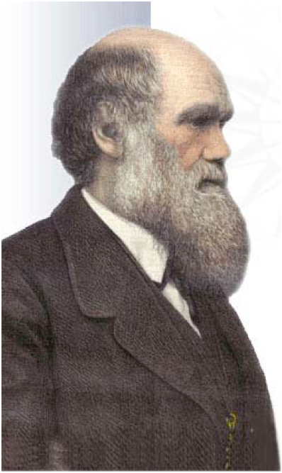
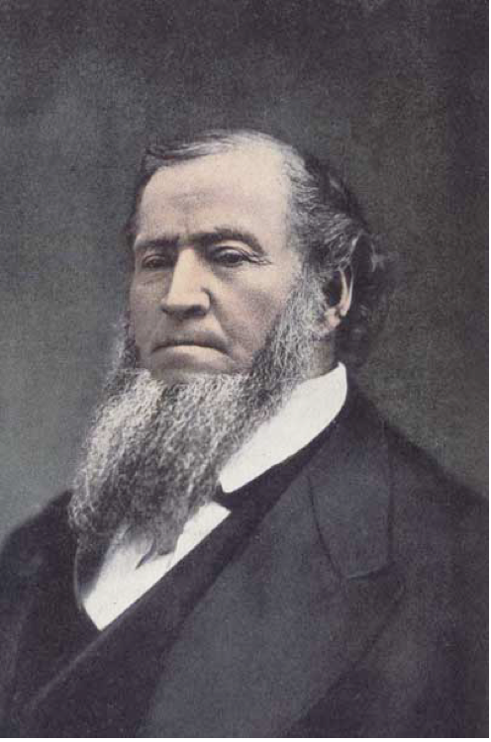
Evolution & The Church of Jesus Christ of Latter-day Saints

Slide 2

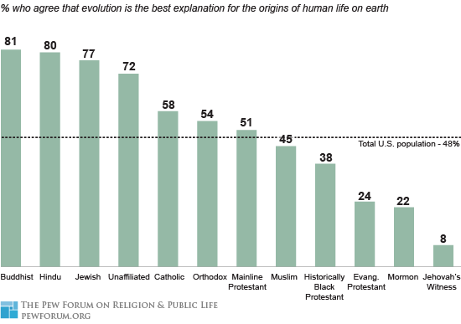
What do people think about evolution as an explanation for the origins of human life on earth?
Pewforum.org, 2008

Slide 3
Current state of our nation
“Evolution is the best explanation for life on earth.”
Pew Forum 2008
US Population

Slide 4
Current State of the Youth
Pew Forum 2008
“Evolution is the best explanation for life on earth.”
Agree
Disagree
Mormon
c²(1) = 10.53, p = .001

Slide 5
Pew Research on “Mormons”
Members of the Church of Jesus Christ of Latter-Day Saints are distinctive in their views on the origins of human life. When asked about the theory of evolution, only 22% of Mormons say it is the best explanation for human life, with three-in-four (75%) disagreeing. Only among one other major religious tradition – Jehovah’s Witnesses (90%) – does a higher proportion disagree that evolution is the best explanation for human life. The general public is more evenly divided on this question, with 48% saying it is the best explanation and 45% rejecting that position.

Slide 6
Gallup 2014
Which of the following statements comes closest to your views on the origin and development of human beings?
Human beings have developed over millions of years from less advanced forms of life, but God guided this process
Human beings have developed over millions of years from less advanced forms of life, but God had no part in this process
God created human beings pretty much in their present form at one time within the last 10,000 years or so

Slide 7
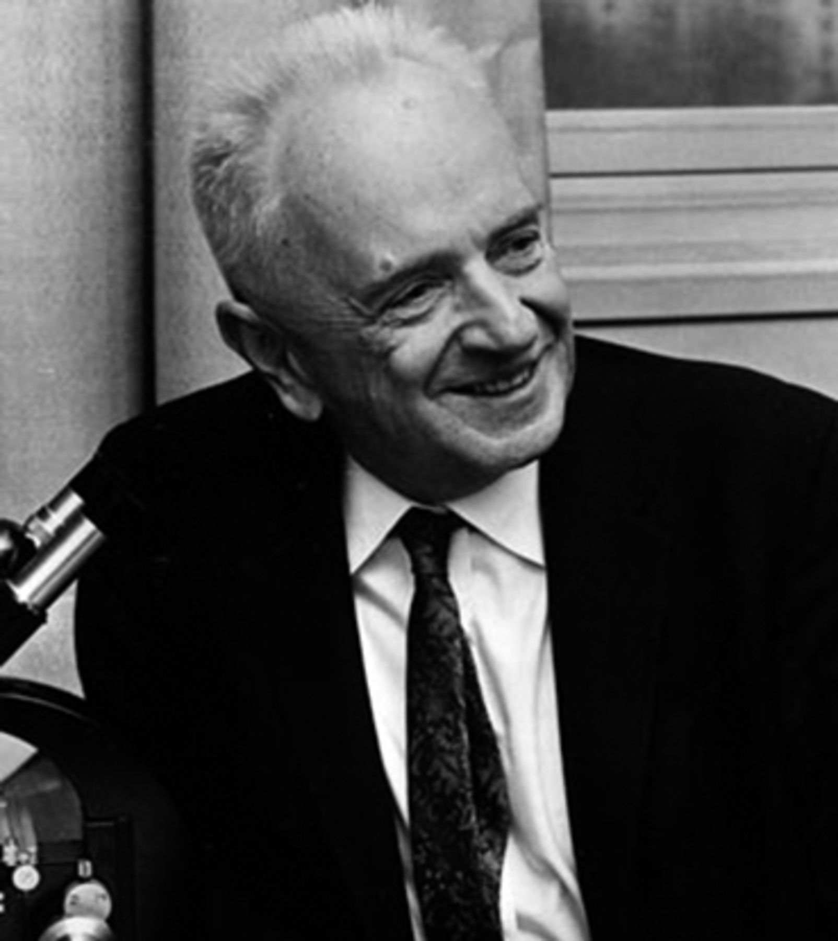
Theodosius Dobzhansky
“Nothing in biology makes sense except in the light of evolution.”

Slide 8
The BIG Picture
In what ways is the the study of evolution compatible with LDS theology?

Slide 9

Science and Religion: Non-overlapping magisteria?
Stephen Jay Gould (1997)
First, what are magisteria?
“A domain where one form of teaching holds the appropriate tools for meaningful discourse and resolution”
Discuss:
Based on this definition, in what ways do you think science and religion are non-overlapping magisteria?

Slide 10
Science and Religion Answer Different Questions
Science:
How?
When?
Religion:
Who?
Why?
“There is no conflict between science and religion. Conflict only arises from an incomplete knowledge of either science or religion, or both…This university is committed to search for truth, and teach the truth,” said Elder Nelson. “All truth is part of the gospel of Jesus Christ. Whether truth comes from a scientific laboratory or by revelation from the Lord, it is compatible.”
Elder Russell M. Nelson said during the dedication of the new Life Sciences Building at Brigham Young University on April 9, 2015.

Slide 11
Science and Religion: Non-overlapping magisteria?
Stephen Jay Gould (1997), and Rock of Ages (1999)
Gould proposed that:
“Science tries to document the factual character of the natural world, and to develop theories that coordinate and explain these facts.
Religion, on the other hand, operates in the equally important, but utterly different, realm of human purposes, meanings, and values — subjects that the factual domain of science might illuminate, but can never resolve.”
What do the scriptures and leaders in the Church say about this matter?

Slide 12
Jacob 4:8 – 9
8 Behold, great and marvelous are the works of the Lord. How unsearchable are the depths of the mysteries of him; and it is impossible that man should find out all his ways. And no man knoweth of his ways save it be revealed unto him; wherefore, brethren, despise not the revelations of God.
9 For behold, by the power of his word man came upon the face of the earth, which earth was created by the power of his word. Wherefore, if God being able to speak and the world was, and to speak and man was created, O then, why not able to command the earth, or the workmanship of his hands upon the face of it, according to his will and pleasure?

Slide 13

Genesis 1
20 And God said, Let the waters bring forth abundantly the moving creature that hath life, and fowl that may fly above the earth in the open firmament of heaven.
21 And God created great whales, and every living creature that moveth, which the waters brought forth abundantly, after their kind, and every winged fowl after his kind: and God saw that it was good.

Slide 14
Genesis 1
26 And God said, Let us make man in our image, after our likeness: and let them have dominion over the fish of the sea, and over the fowl of the air, and over the cattle, and over all the earth, and over every creeping thing that creepeth upon the earth.
27 So God created man in his own image, in the image of God created he him; male and female created he them.

Slide 15
Are We Creationists?

Slide 16
Creationist Creed
“Since nothing in the world has been created since the end of the creation period, everything must then have been created by means or processes which are no longer in operation and which we therefore cannot study by any of the means of science. We are limited exclusively to divine revelation as to the date of creation, the duration of creation, the method of creation, and every other question concerning creation.”
Henry Morris (Creation Research Institute)
Notes:
Based on the premise that the mechanisms of creation are not open to scientific investigation.
This is a very different view from the LDS packet
“Our religion is not hostile to real science. That which is demonstrated, we accept with joy….”

Slide 17
Creationist History
1910-1915 : A set of Christian tracts emerged in the US which took a literalistic interpretation of Genesis (ex nihilo creation).
1920-1968: Evolution banned from public schools
1963: Creation Research Society, Institute for Creation Research
1975: “Equal Time” (Tennessee)
1981, 1987: “Balanced treatment” (Arkansas, Louisiana)
1995 – 1996: “Evolution as theory” (Tennessee)
2000: “Intelligent Design”
Notes:
Creation Research Society, Institute for Creation Research: Societies created in an effort to make creationism more ‘scientific’. However, these efforts served only to try to discredit evolution.
Equal Time (from Wikipedia): Daniel v. Waters, 515 F.2d 485 (6th Cir. 1975)^{[1]} was a 1975 legal case in which the United States Court of Appeals for the Sixth Circuit struck down Tennessee's law regarding the teaching of "equal time" of evolution and creationism in public school science classes because it violated the Establishment clause of the US Constitution.
The plaintiffs were school teachers supported by the National Association of Biology Teachers.
Balanced Treatment (from Wikipedia): McLean v. Arkansas Board of Education, 529 F. Supp. 1255, 1258-1264 (ED Ark. 1982), was a 1981 legal case in Arkansas.
A lawsuit was filed in the United States District Court for the Eastern District of Arkansas by various parents, religious groups and organizations, biologists, and others who argued that the Arkansas state law known as the Balanced Treatment for Creation-Science and Evolution-Science Act(Act 590), which mandated the teaching of "creation science" in Arkansas public schools, was unconstitutional because it violated the Establishment Clause of the First Amendment to the United States Constitution.
Judge William Overton handed down a decision on January 5, 1982, giving a clear, specific definition of science as a basis for ruling that creation science is religion and is simply not science. The ruling was not binding on schools outside the Eastern District of Arkansas but had considerable influence on subsequent rulings on the teaching of creationism.^{[1][2]}
Arkansas did not appeal the decision and it was not until the 1987 case of Edwards v. Aguillard, which dealt with a similar law passed by the State of Louisiana, that teaching "creation science" was ruled unconstitutional by the Supreme Court, making that determination applicable nationwide.^{[3]}
Evolution as a theory: In 1996, the State of Tennessee debated and narrowly defeated a bill that would have made teachers who taught evolution as a fact - rather than as a theory - subject to dismissal for insubordination (Matsumura 1995b). In late 1995, Alabama passed a state science curriculum that required that evolution be taught "as theory rather than fact" (Scott 1995). These are not the first such cases; NCSE has records of school-board controversies or individual teachers' complaints concerning pressure to teach evolution as a theory and not fact from Alabama, Arkansas, California, Florida, Georgia, Louisiana, Pennsylvania, Texas, and Wisconsin, among other places.
Intelligent Design (from IntelligentDesign.org) What is intelligent design? Intelligent design refers to a scientific research program as well as a community of scientists, philosophers and other scholars who seek evidence of design in nature. The theory of intelligent design holds that certain features of the universe and of living things are best explained by an intelligent cause, not an undirected process such as natural selection. Through the study and analysis of a system's components, a design theorist is able to determine whether various natural structures are the product of chance, natural law, intelligent design, or some combination thereof. Such research is conducted by observing the types of information produced when intelligent agents act. Scientists then seek to find objects which have those same types of informational properties which we commonly know come from intelligence. Intelligent design has applied these scientific methods to detect design in irreducibly complex biological structures, the complex and specified information content in DNA, the life-sustaining physical architecture of the universe, and the geologically rapid origin of biological diversity in the fossil record during the Cambrian explosion approximately 530 million years ago.

Slide 18
Intelligent design
Intelligent design refers to a scientific research program as well as a community of scientists, philosophers and other scholars who seek evidence of design in nature. The theory of intelligent design holds that certain features of the universe and of living things are best explained by an intelligent cause, not an undirected process such as natural selection. Through the study and analysis of a system's components, a design theorist is able to determine whether various natural structures are the product of chance, natural law, intelligent design, or some combination thereof. Such research is conducted by observing the types of information produced when intelligent agents act. Scientists then seek to find objects which have those same types of informational properties which we commonly know come from intelligence. Intelligent design has applied these scientific methods to detect design in irreducibly complex biological structures, the complex and specified information content in DNA, the life-sustaining physical architecture of the universe, and the geologically rapid origin of biological diversity in the fossil record during the Cambrian explosion approximately 530 million years ago.
Notes:
Creation Research Society, Institute for Creation Research: Societies created in an effort to make creationism more ‘scientific’. However, these efforts served only to try to discredit evolution.
Equal Time (from Wikipedia): Daniel v. Waters, 515 F.2d 485 (6th Cir. 1975)^{[1]} was a 1975 legal case in which the United States Court of Appeals for the Sixth Circuit struck down Tennessee's law regarding the teaching of "equal time" of evolution and creationism in public school science classes because it violated the Establishment clause of the US Constitution.
The plaintiffs were school teachers supported by the National Association of Biology Teachers.
Balanced Treatment (from Wikipedia): McLean v. Arkansas Board of Education, 529 F. Supp. 1255, 1258-1264 (ED Ark. 1982), was a 1981 legal case in Arkansas.
A lawsuit was filed in the United States District Court for the Eastern District of Arkansas by various parents, religious groups and organizations, biologists, and others who argued that the Arkansas state law known as the Balanced Treatment for Creation-Science and Evolution-Science Act(Act 590), which mandated the teaching of "creation science" in Arkansas public schools, was unconstitutional because it violated the Establishment Clause of the First Amendment to the United States Constitution.
Judge William Overton handed down a decision on January 5, 1982, giving a clear, specific definition of science as a basis for ruling that creation science is religion and is simply not science. The ruling was not binding on schools outside the Eastern District of Arkansas but had considerable influence on subsequent rulings on the teaching of creationism.^{[1][2]}
Arkansas did not appeal the decision and it was not until the 1987 case of Edwards v. Aguillard, which dealt with a similar law passed by the State of Louisiana, that teaching "creation science" was ruled unconstitutional by the Supreme Court, making that determination applicable nationwide.^{[3]}
Evolution as a theory: In 1996, the State of Tennessee debated and narrowly defeated a bill that would have made teachers who taught evolution as a fact - rather than as a theory - subject to dismissal for insubordination (Matsumura 1995b). In late 1995, Alabama passed a state science curriculum that required that evolution be taught "as theory rather than fact" (Scott 1995). These are not the first such cases; NCSE has records of school-board controversies or individual teachers' complaints concerning pressure to teach evolution as a theory and not fact from Alabama, Arkansas, California, Florida, Georgia, Louisiana, Pennsylvania, Texas, and Wisconsin, among other places.
Intelligent Design (from IntelligentDesign.org) What is intelligent design? Intelligent design refers to a scientific research program as well as a community of scientists, philosophers and other scholars who seek evidence of design in nature. The theory of intelligent design holds that certain features of the universe and of living things are best explained by an intelligent cause, not an undirected process such as natural selection. Through the study and analysis of a system's components, a design theorist is able to determine whether various natural structures are the product of chance, natural law, intelligent design, or some combination thereof. Such research is conducted by observing the types of information produced when intelligent agents act. Scientists then seek to find objects which have those same types of informational properties which we commonly know come from intelligence. Intelligent design has applied these scientific methods to detect design in irreducibly complex biological structures, the complex and specified information content in DNA, the life-sustaining physical architecture of the universe, and the geologically rapid origin of biological diversity in the fossil record during the Cambrian explosion approximately 530 million years ago.

Slide 19
What is the Church’s stance on evolution?
Are we ‘creationists’?
Notes:
We are lucky in being LDS, in that we have a greater knowledge of the creation and the fall than any other religion. The Books of Moses and Abraham both specifically deal with creation, as well as the Temple. The Book of Mormon also provides marvelous insights into the why’s of creation.

Slide 20
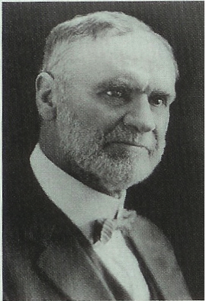
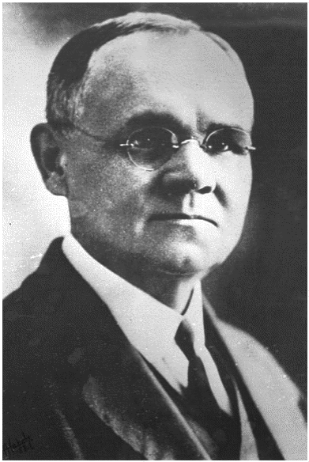
Official statements of the Church on evolution
08 – First Presidency (Joseph F. Smith, President) appoints a committee to prepare a statement on the Origin of Man
Why ?
Orson Whitney
James Talmage
1900
1925
1950
1975
2000

Slide 21
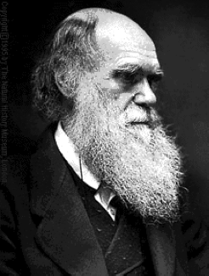
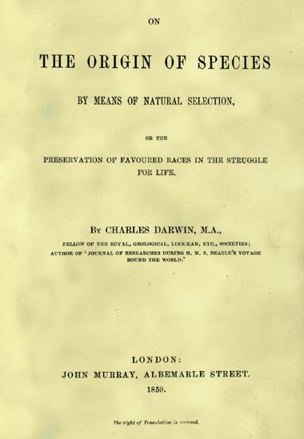
Born 1809
Published 1859

Slide 22
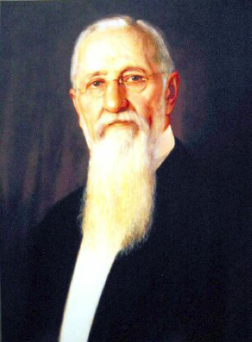
Official statements of the Church on evolution
09 – The Statement is Published in the Improvement Era
over the signature of the First Presidency
President
Joseph F. Smith
1. Adam took upon himself
“an appropriate body”
2. Anti-evolution tone is clear,
but no explicit rejection of
evolution
1900
1925
1950
1975
2000

Slide 23
Official statements of the Church on evolution
10 – First Presidency Christmas Message – “Our religion is not hostile to real science. That which is demonstrated we accept with joy.”
President
Joseph F. Smith
Image: LDS church
1900
1925
1950
1975
2000

Slide 24
Our Church embraces science, and always has:
Joseph Smith, 1843: “One of the grand fundamental principles of ‘Mormonism’ is to receive truth, let it come from which it may.”
“[The twentieth century] has been the best of all centuries. … The life expectancy of man has been extended by more than twenty-five years… The fruits of science have been manifest everywhere… This has been an age of enlightenment.” - President Gordon B. Hinckley, April 1999
Notes:
In dealing with this hypothesis, I want to point out a couple of things.
First, I want to emphasize that the Official position of the Church toward science has not changed since its inception back in the 1800’s. Joseph Smith, the founding prophet of our Church said…
The First Presidency of the Church, which includes the current Prophet and his two counselors said, in 1910…
And a recent Prophet of the Church said in 1999…

Slide 25
Brigham Young
I am not astonished that infidelity prevails to a great extent among the inhabitants of the earth, for the religious teachers of the people advance many ideas and notions for the truth which are in opposition to and contradict facts demonstrated by science.
In these respects we differ from the Christian world, for our religion will not clash with or contradict the facts of science in any particular. You may take geology, for instance, and it is true science. . . . To assert that the Lord made this earth out of nothing is preposterous and impossible.

Slide 26
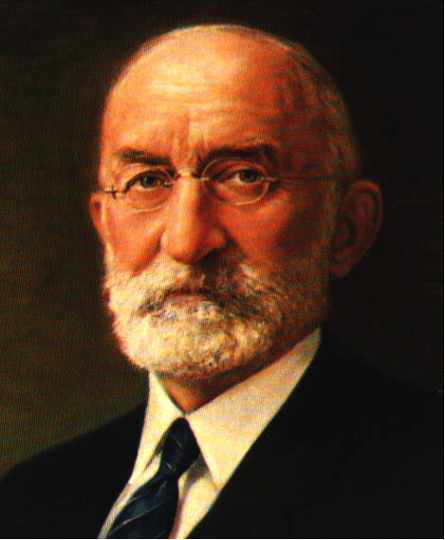
Official statements of the Church on evolution
25 – The Mormon View of Evolution
President
Heber J. Grant
(1918-1945)
Why?
This is a shortened version of
The 1909 statement, but with the
anti-evolution sentiments removed.
1900
1925
1950
1975
2000

Slide 27
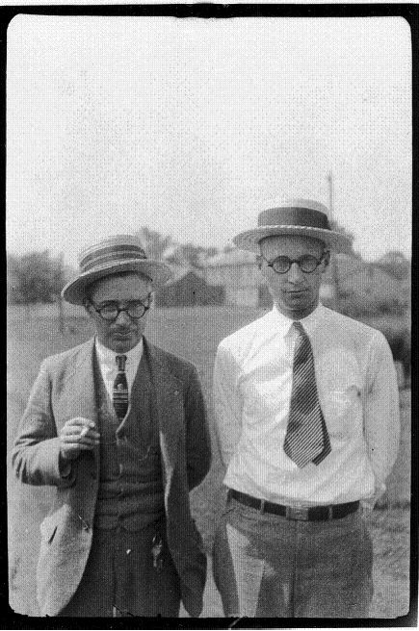
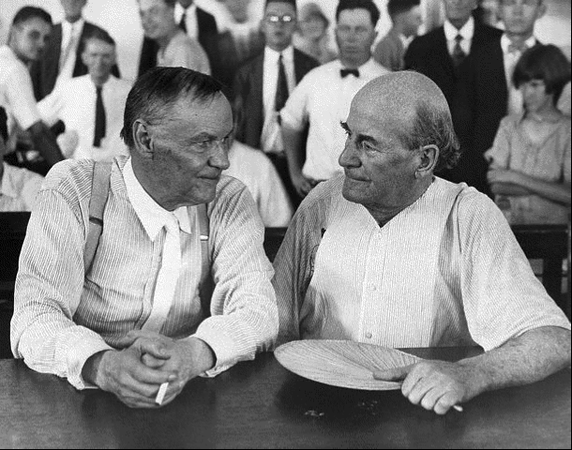
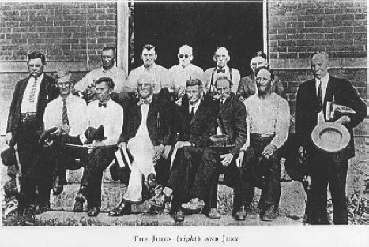

Scopes “Monkey Trial” (10-25 July 1925)
William Jennings Bryan
Clarence Darrow
John Thomas Scopes
Notes:
Kentucky
Clarence Darrow - Lawyer
William Jennings Bryan — lawmaker
John Thomas Scopes

Slide 28
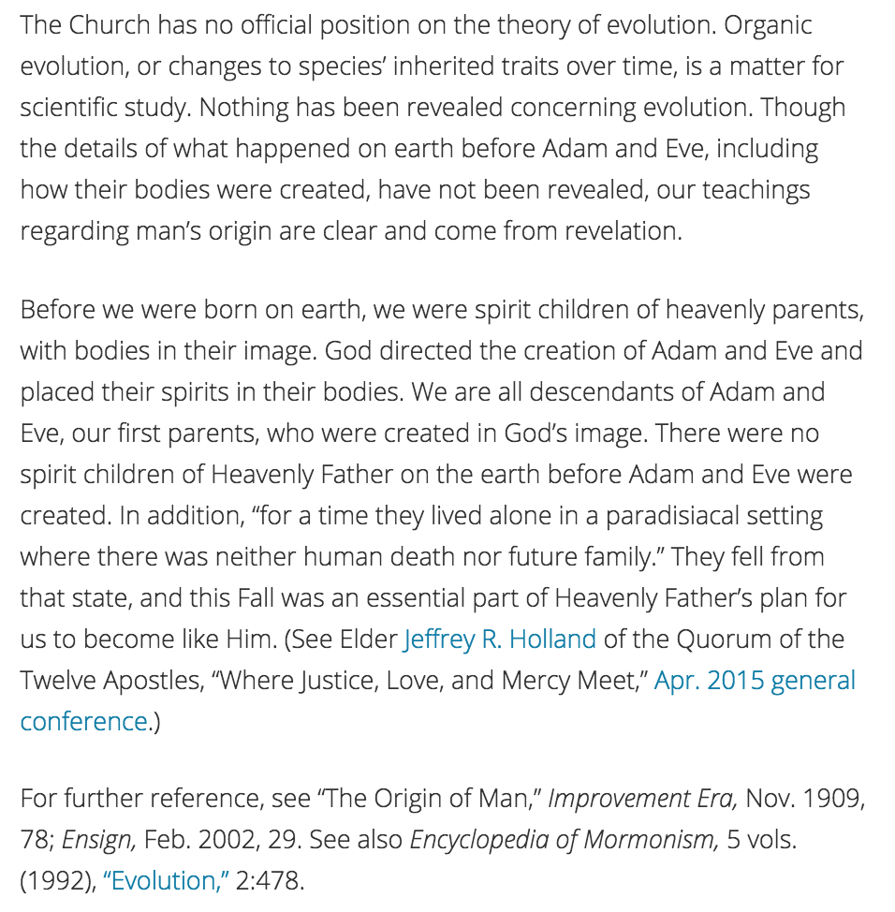
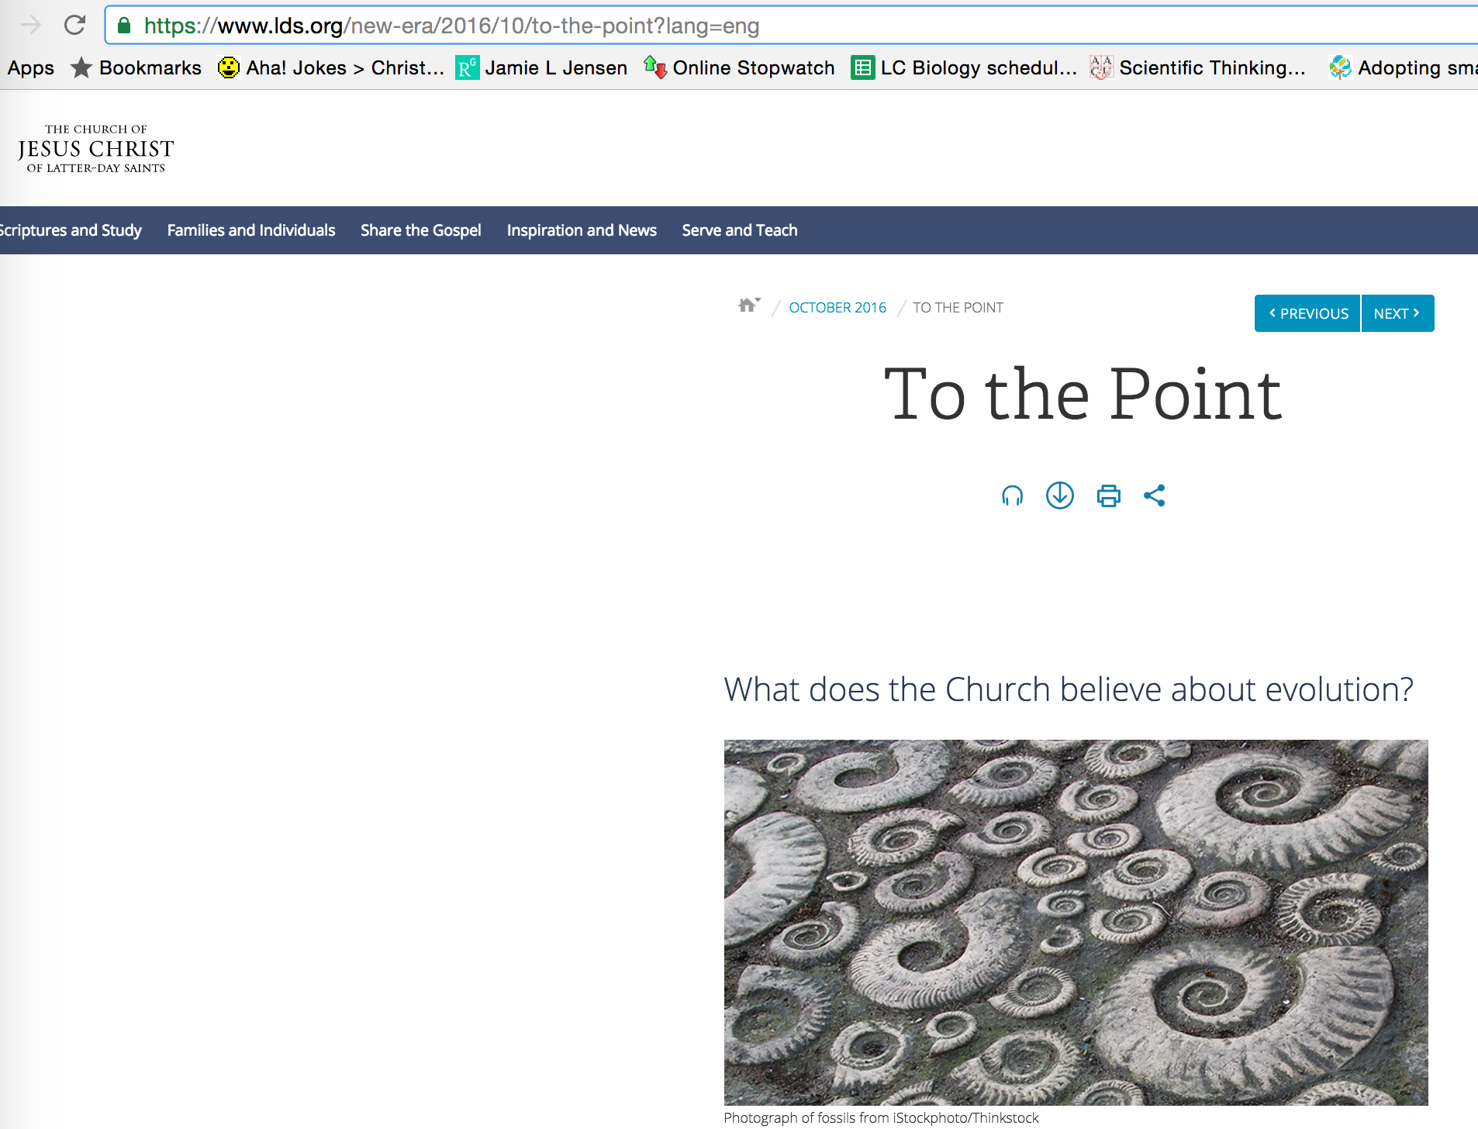
History of the Church and Evolution
2016 – New Era
1900
1925
1950
1975
2000

Slide 29
LDS Position on the Creation/Evolution
"Did dinosaurs live and die on this earth long before man came along? There have been no revelations on this question, and the scientific evidence says yes. (You can learn more about it by studying paleontology if you like, even at Church-owned schools.)
The details of what happened on this planet before Adam and Eve aren’t a huge doctrinal concern of ours. The accounts of the Creation in the scriptures are not meant to provide a literal, scientific explanation of the specific processes, time periods, or events involved. What matters to us is that as part of His plan for us, God created the earth and then created Adam and Eve, who were our first parents and were instrumental in bringing about the Fall, which enabled us to be born on earth and participate in God’s plan."
New Era, 2016

Slide 30
Why is there so much perceived controversy in our culture?

Slide 31
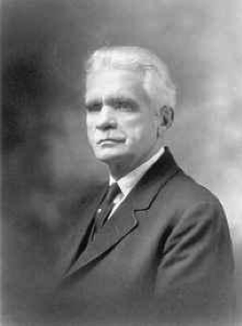

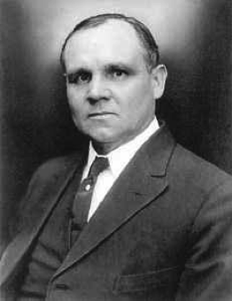
History of the Church and Evolution
(28 – 31) – Dispute between B.H. Roberts and Joseph Fielding Smith. First Presidency sanctioned a response by James Talmage.
University of Utah collections
University of Utah collections
B.H.Roberts
Joseph Fielding Smith
The Truth, The Way, The Life
1900
1925
1950
1975
2000
University of Utah collections
James Talmage
The Earth and Man
Notes:
Joseph Fielding was an apostle at the time — not president of the church until 1970
Talmage was an apostle at the time as well
BH Roberts was in Presidency of Seventy

Slide 32
The Talmage speech was given in the Tabernacle in August 1931, and, after some resistance from Elder Smith but with the blessing of the First Presidency, it was published first in the Church News and then by the church as a pamphlet. In the speech, Elder Talmage (a geologist by training) strongly emphasized that countless organisms had lived and died for millions of years before the fall of Adam, some small portion of them becoming fossils. He also quoted scripture and expressed his conviction that Adam was indeed the first member of the human race, that we existed previously in heaven, and that we were created in the image of God.

Slide 33
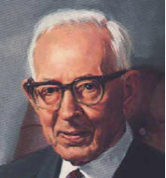
History of the Church and Evolution
54 – Joseph Fielding Smith publishes his anti-evolutionary book Man His Origin and Destiny
David O. McKay
prophet at the time
President J. Rueben Clark gives
his famous talk “When are church
leaders’ words (considered)
scripture”
Joseph Fielding Smith
1900
1925
1950
1975
2000

Slide 34
Q. Who provides official church doctrine?
A. Prophet (First Presidency)
President Clark stated, "When any man, except
the president of the church, undertakes to proclaim
one unsettled doctrine, as among two or more
doctrines, in dispute, as the settled doctrine of
the church, we may know that he is not 'moved upon
by the Holy Ghost,' unless he is acting under the
direction and by authority of the president."
Also see http://www.mormonnewsroom.org/article/approaching-mormon-doctrine

Slide 35
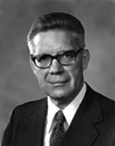
History of the Church and Evolution
58 – Bruce R. McConkie publishes Mormon Doctrine
David O. McKay
prophet at the time
Bruce R. McConkie
1900
1925
1950
1975
2000

Slide 36
Predictably, the publication of Mormon Doctrine reignited the debate surrounding the church's position on evolutionary theory. The "number of inquiries we receive concerning our attitudes on the teaching . . . that death came into the world with the fall of Adam . . . has intensified," wrote Armin J. Hill, dean of BYU's College of Physical and Engineering Sciences, to President McKay in early 1959. While "we accept the Fall as initiating physical death among human beings," Hill explained, McConkie's assertion that there was no death for "all living things" prior to the Fall "cannot be referring to the world we now live in because there is altogether too much evidence that plants and animals lived and died prior to the time we usually ascribe to Adam's mortal life."
Nearly two months later, the First Presidency directed secretary Joseph Anderson to answer, "Until either the Lord speaks directly upon the matter, or until the scientists are able to say that they have the ultimate truth concerning these matters, it would only be confusing for the First Presidency to make any statement regarding such things." Two weeks after receiving Hill's letter, President McKay was asked specifically if Mormon Doctrine represented the church's position on evolution and responded that, like Man: His Origin and Destiny, Mormon Doctrine was not an "official publication of the church," adding, "The church has issued no official statement on the subject of the theory of evolution" (McKay to Christensen).⁵⁶

Slide 37
Twenty years after B. H. Roberts, Widtsoe acknowledged the existence of "human-like [p. 152] beings before the coming of Adam," adding, "The mystery of the creation of Adam has not yet been revealed." To one reader, Widtsoe privately explained in 1948, "If [the Lord] chose to place man-like beings upon the earth before the days of Adam, I really have no right to find fault with that. . . . There is so much connected with these matters that we do not understand that I am willing to take what little we know of a factual nature without offering any interpretations that may mislead others."⁴³

Slide 38
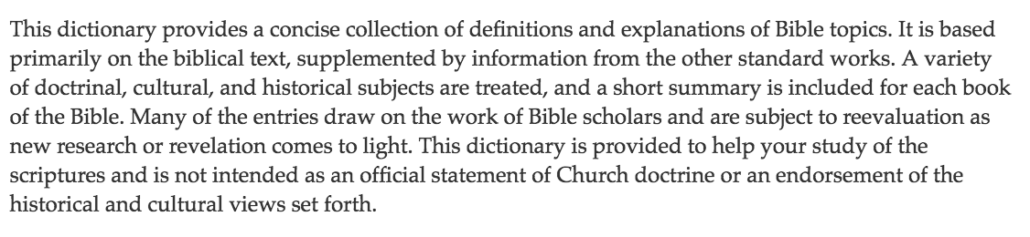
History of the Church and Evolution
70’s – Bible Dictionary
https://www.lds.org/scriptures/bd?lang=eng
“Since 1979, [the] Bible Dictionary has been published as an appendix to most copies of the King James Version (KJV) of the Bible printed by the LDS Church…[It] was created in the 1970s by the Scriptures Publications Committee of the LDS Church. This committee was chaired by Thomas S. Monson, then a member of the Quorum of the Twelve Apostles. The committee delegated the responsibility of creating an LDS bible dictionary to Robert J. Matthews, a Brigham Young University Professor of Ancient Scripture. Matthews gained permission from Cambridge University Press to use their bible dictionary as the template for the LDS version…the majority of the content of the Bible Dictionary is identical to the Cambridge publication.
1900
1925
1950
1975
2000
Notes:
No death before the fall was said by McConkie in his book. It is also in the Bible Dictionary. The Bible Dictionary was written by Robert J. Matthews. So, McConkie got that verbiage from Matthews.

Slide 39
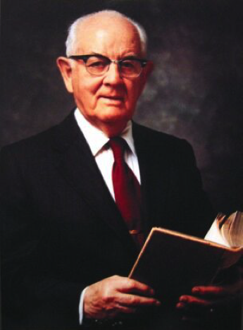
History of the Church and Evolution
75 – President Kimball addresses the General Women’s Conference
“We don’t know” how Adam and Eve got their bodies, but “the story of the rib, of course, is figurative.”
Ensign 3.1976:70-72
President
Spencer W. Kimball
1900
1925
1950
1975
2000

Slide 40

History of the Church and Evolution
92 – Encylopedia of Mormonism & “BYU Evolution Packet”
Encyclopedia entry on ‘evolution’ written over Evenson’s signature but with significant input from the First Presidency
BYU Dean
Bill Evenson
1900
1925
1950
1975
2000

Slide 41
What does this mean for you?
"Religion without science is blind," Albert Einstein once observed, and "science without religion is lame.”
Veteran BYU geologist George Hansen has echoed: "Science and religion have to go hand in hand--that's part of the greatness of BYU. . . . Kids who come through [the university] are endowed with a feeling of uniformity of [truth], . . . but you can't memorize one passage of scripture and know all the answers to all the problems of the universe."80

Slide 42
We shouldn’t expect to know all things at this point
Doctrine and Covenants 101:32-33
In that day when the Lord shall come, he shall reveal all things--Things which have passed, and hidden things which no man knew, things of the earth, by which it was made, and the purpose and the end thereof.

Slide 43
What does this mean for you?
Flat Earth
Young Earth
Special Creation
Geocentrism
Universal Model
Young Earth Creationism
Intelligent Design
Old Earth
Gap Creationism
Day-Age Creationism
Progressive Creationism
Theistic Evolution
Potentially Scientifically Compatible
Agnostic Evolution
Atheistic Evolution
Notes:
Young earth creationism — six 24 hr periods
Gap creationism: 6 24 hr creative periods with large expanses of time between them
Day - Age creationism: days were much longer periods
Progressive - God created new forms of life gradually over a period of hundreds of millions of years
Theistic Evolution — God-guided evolution
Agnostic Evolution — evolution occurred but no statement regarding existence of God
Atheistic Evolution — claiming science disproves God

Slide 44

And behold, all things have their likeness, and all things are created and made to bear record of me, both things which are temporal, and things which are spiritual; things which are in the heavens above, and things which are on the earth, and things which are in the earth, and things which are under the earth, both above and beneath: all things bear record of me.
Moses 6:63

Slide 45


Slide 46
It’s magic!
Smoothini the Ghetto Houdini:
https://www.youtube.com/watch?v=ZTy3qG_qInU&vl=en

Slide 47
Time for questions
What questions/concerns do you have?
But what about…?
Doesn’t evolution say that …?

Slide 48

Discuss with your neighbors
What is your current perspective of evolution?
Specifically, do you think it is valid, and does it necessarily disagree with an LDS perspective on the Creation?

Slide 49
Central Events of Eternity
Fall
Creation
Atonement

Slide 50



Alma 30:44 . . . [A]ll things denote that there is a God; yea even the earth, and all things that are upon the face of it.

Slide 51
Brigham Young
I am not astonished that infidelity prevails to a great extent among the inhabitants of the earth, for the religious teachers of the people advance many ideas and notions for the truth which are in opposition to and contradict facts demonstrated by science.
In these respects we differ from the Christian world, for our religion will not clash with or contradict the facts of science in any particular. You may take geology, for instance, and it is true science. . . . To assert that the Lord made this earth out of nothing is preposterous and impossible.

Slide 52
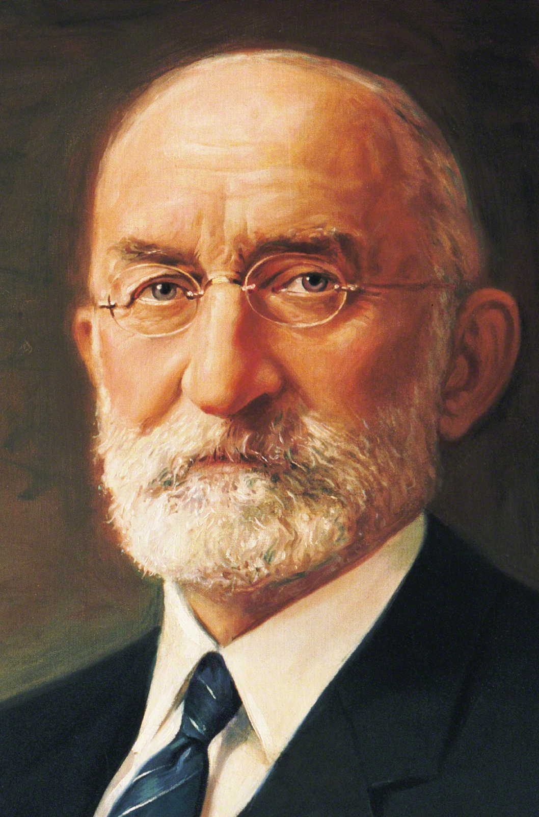
First Presidency Memo to GAs in 1931
"Upon the fundamental doctrines of the Church we are all agreed. Our mission is to bear the message of the restored Gospel to the people of the world. Leave geology, biology, archaeology and anthropology, no one of which has to do with the salvation of the souls of mankind, to scientific research, while we magnify our calling in the realm of the Church."

Slide 53

Elder Russell M. Nelson, Dedication of BYU Life Sciences Building
All truth is part of the gospel of Jesus Christ. Whether truth comes from a scientific laboratory or by revelation from the Lord, it is all compatible…
Conflict only arises from an incomplete knowledge of either science or religion, or both.

Slide 54
We shouldn’t expect to know all things at this point
Doctrine and Covenants 101:32-33
In that day when the Lord shall come, he shall reveal all things--Things which have passed, and hidden things which no man knew, things of the earth, by which it was made, and the purpose and the end thereof.

Slide 55
LDS Position on the Creation/Evolution
God created man in his own image, in the image of God created he him; male and female created he them
Adam, our great progenitor, “the first man,” was like Christ, a pre-existent spirit, and, like Christ, he took upon him an appropriate body, the body of a man, and so became a “living soul.”
By his Almighty power God organized the earth, and all that it contains, from spirit and element, which exist co-eternally with himself
Man is the child of God

Slide 56
LDS Position on the Creation/Evolution
"Did dinosaurs live and die on this earth long before man came along? There have been no revelations on this question, and the scientific evidence says yes. (You can learn more about it by studying paleontology if you like, even at Church-owned schools.)
The details of what happened on this planet before Adam and Eve aren’t a huge doctrinal concern of ours. The accounts of the Creation in the scriptures are not meant to provide a literal, scientific explanation of the specific processes, time periods, or events involved. What matters to us is that as part of His plan for us, God created the earth and then created Adam and Eve, who were our first parents and were instrumental in bringing about the Fall, which enabled us to be born on earth and participate in God’s plan."
New Era, 2016

Slide 57
LDS Position on the Creation/Evolution
Why do you think that the LDS community has struggled with the ‘evolution’ question?
Does acceptance of the theory of evolution diminish or strengthen your view of God?

Slide 58
And behold, all things have their likeness, and all things are created and made to bear record of me, both things which are temporal, and things which are spiritual; things which are in the heavens above, and things which are on the earth, and things which are in the earth, and things which are under the earth, both above and beneath: all things bear record of me.
Moses 6:63

Slide 59
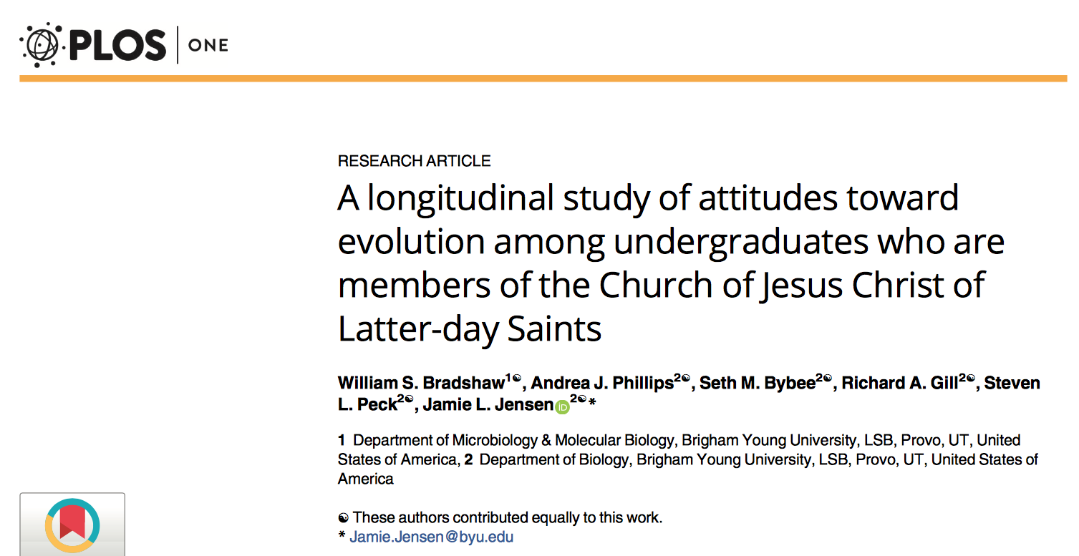

Slide 60
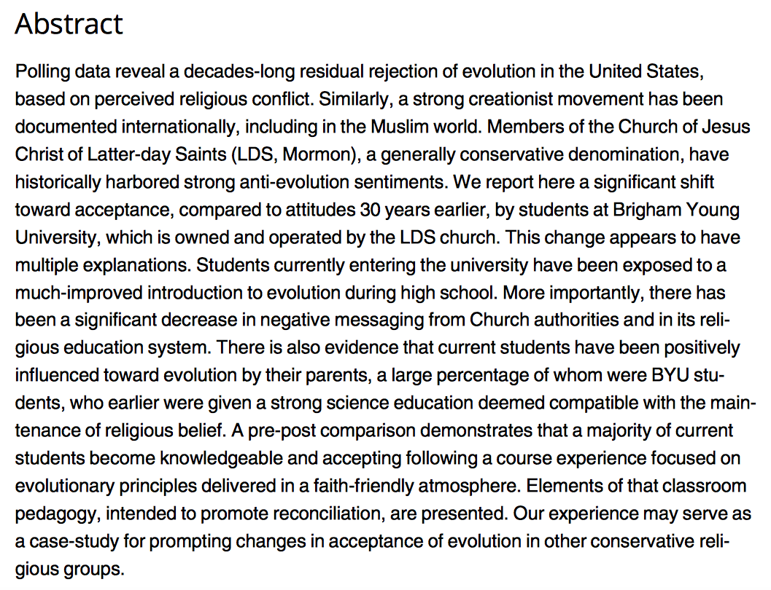

Slide 61
Time for questions
What questions/concerns do you have?
But what about…?
Doesn’t evolution say that …?

Slide 62
Note: I’ve posted the Evolution Packet that is distributed in similar biology courses at BYU Provo. Please read this if you are interested. I’ve also provided a brief timeline here that puts some of the statements from the First Presidency on Evolution in historical context. On Canvas you will find the Evolution Packet, a PDF of a talk by J. Reuben Clark mentioned in the timeline, and the recently published study on perceptions of evolution in BYU students.

Slide 64
Evolution and LDS Theology: A Historical Analysis

Slide 65

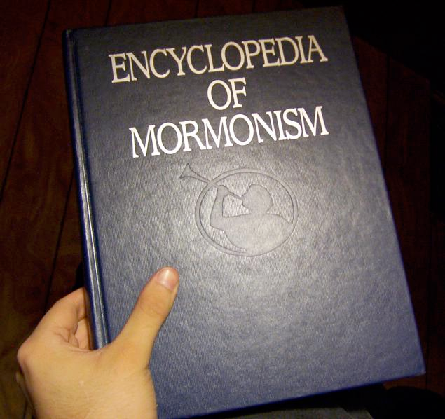
BYU Packet - ‘Evolution & The Origin of Man’
Macmillan Publishers -1992

Slide 66
A Historical Context
1801--Brigham Young’s Birth
1809--Darwin’s Birth
1800
1850
1900
1950
2000

Slide 67
A Historical Context
1859--Publishing of The Origin of Species
1847--Saints Arrive in Salt Lake Valley
1866--Mendel publishes his first work
1801--Brigham Young’s Birth
1809--Darwin’s Birth
1800
1850
1900
1950
2000

Slide 68

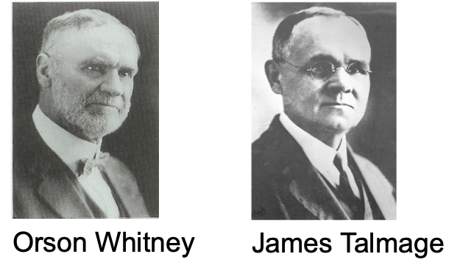
A Historical Context
1908--First Presidency (Joseph F. Smith, President) appoint a committee to prepare a statement on the Origin of Man
1800
1850
1900
1950
2000

Slide 69
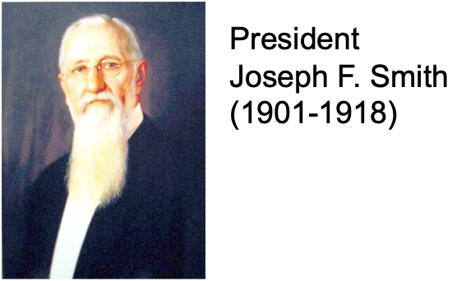
A Historical Context
1909--Statement on the Origin of Man published in the Improvement Era over the signature of the First Presidency
1. Adam took upon himself “an appropriate body”
2. Anti-evolution tone is clear, but no explicit rejection of evolution
1800
1850
1900
1950
2000

Slide 70
A Historical Context
1910--Priesthood Quorum Table--Response to “high priest quorums” regarding the origin of Adam’s body
Three Options:
Divinely directed evolution
Interplanetary transport
“Born here in mortality as other mortals have been”
Note: No so-called “literal reading”
of Genesis.
1800
1850
1900
1950
2000

Slide 71

A Historical Context
1910--First Presidency Christmas Message “Our religion is not hostile to real science. That which is demonstrated we accept with joy.”
1800
1850
1900
1950
2000

Slide 72
A Historical Context
1911--Improvement Era editorial--Invites (BYU) biologists to focus on pest control and not the origin of life. Suggests that evolution is ‘more or less a fallacy’ but points out that the Church has no official position on how the Lord created the Earth
1800
1850
1900
1950
2000

Slide 73

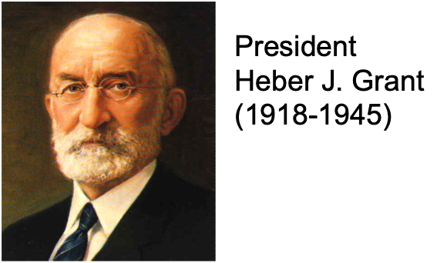
A Historical Context
1925--The Mormon View of Evolution
Why 1925?
Shortened version of the 1909 statement, with the anti-evolution statements redacted
1800
1850
1900
1950
2000

Slide 74
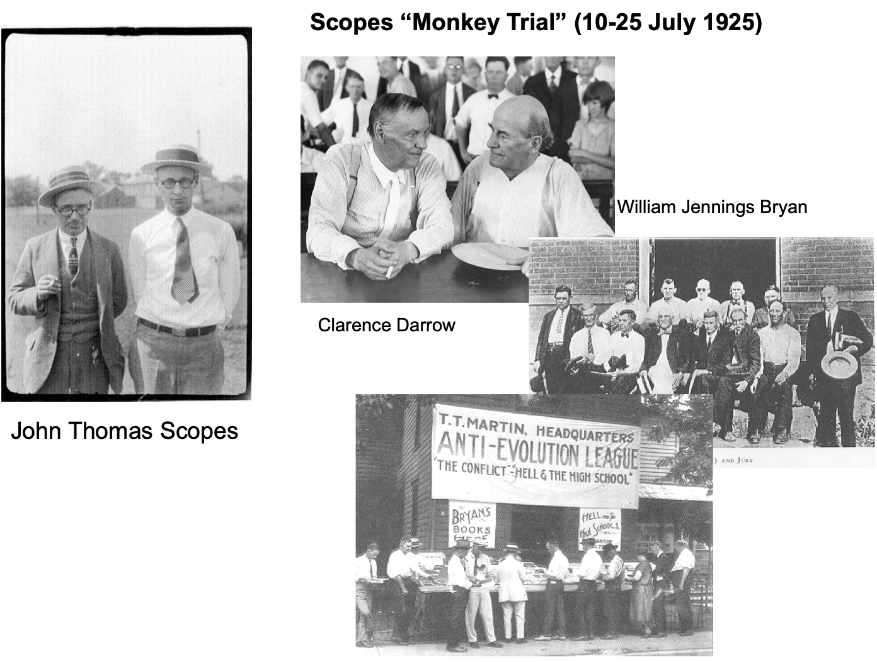
Scopes Monkey Trial
Unlawful "to teach any theory that denies the story of the Divine Creation of man as taught in the Bible, and to teach instead that man has descended from a lower order of animals.”
- Butler Act

Slide 75

Efforts to eliminate teaching Theory of Evolution in public schools in the US
1. Outlaw teaching evolution (1920’s): Monkey Trials
2. Teach “Creation Science” (1960’s)
3. Teach “Intelligent Design” (2000’s)

Slide 76

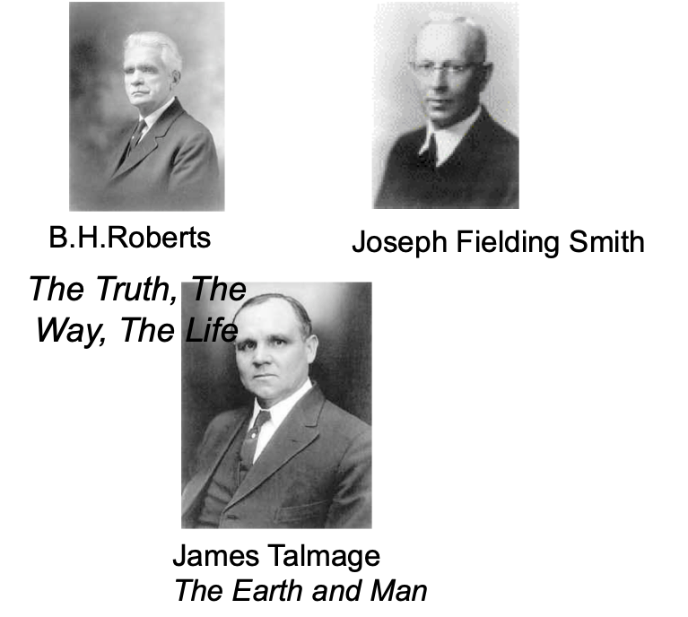
A Historical Context
1928-31--Dispute between BH Roberts and Joseph Fielding Smith; James Talmage provides First Presidency sanctioned response
1800
1850
1900
1950
2000

Slide 77
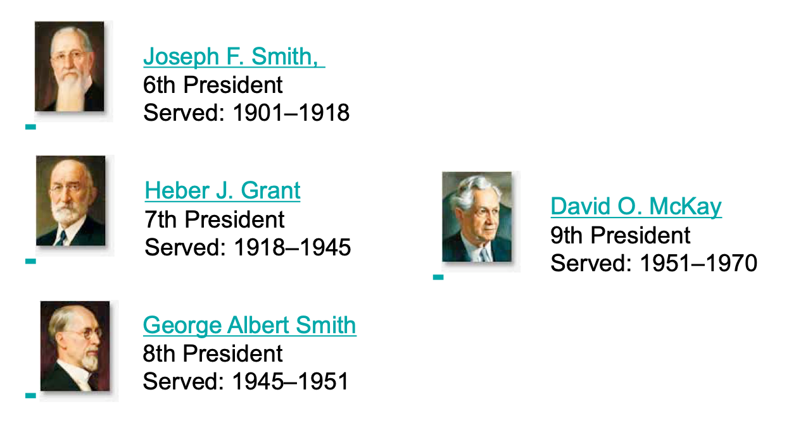
Quiet Period

Slide 78


A Historical Context
1954--Joseph Fielding Smith publishes Man: His Origin and Destiny
Strongly Anti Evolutionary
President J. Rueben Clark gives talk “When are church leaders’ words entitled to the claim of scripture?”
David O. McKay Prophet
1800
1850
1900
1950
2000

Slide 79


A Historical Context
1958--Bruce R. McConkie publishes Mormon Doctrine
David O. McKay Prophet
1800
1850
1900
1950
2000

Slide 80

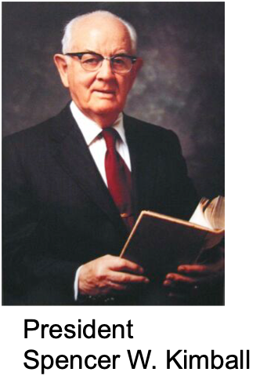
A Historical Context
1975--President Kimball addresses the General Women’s Conference
We don’t know how Adam and Eve got their bodies, but “the story of the rib, of course, is figurative
1800
1850
1900
1950
2000

Slide 81

A Historical Context
BYU Evolution Packet
1992 Encyclopedia of Mormonism
1800
1850
1900
1950
2000

Slide 82

A Historical Context
2009--200th Birthday & 150th Anniversary of Origin
1800
1850
1900
1950
2000

Slide 83
